Slide 1
Natural Language Processing
CSCI 5832—Lecture 15
Jim Martin

Slide 2
Today
Moving from words to larger units of analysis
Syntax and Grammars
Context-free grammars
Grammars for English
Treebanks
Moving on to Chapters 10, 11,12,and 13

Slide 3
Syntax
By syntax, I mean the kind of knowledge of your native language not directly related to meaning that you had mastered by the time you were 3 years old without any explicit instruction.

Slide 4
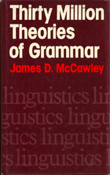
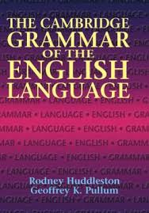
Syntax in Linguistics
Theoretical frameworks: Phrase-structure grammars, transformational syntax, X-bar theory, principles and parameters, government and binding, GPSG, HPSG, LFG, relational grammar, minimalism…
Reference grammars: less focus on theory and more on capturing the facts about specific languages

Slide 5
Syntax
Why do we care about syntax?
Syntactic knowledge is key to many practical applications
Grammar checkers (as in MS Word)
Question answering
Information extraction
Machine translation
Language learning

Slide 6
Syntax
Key notions that we will cover
Constituency and ordering
Grammatical and dependency relations
Heads, agreement, grammatical function
Key formalisms
Context-free grammars (inc. CCG)
Dependency grammars
Resources
Treebanks

Slide 7
Constituency
The basic idea is that groups of words within utterances can be shown to act as single units in some respects
These units form coherent classes that behave in similar ways
With respect to their internal structure
And with respect to other units in the language

Slide 8
Constituency
Internal structure
We can associate an internal structure with each class
External behavior
We can talk about the constituents that each class commonly associates with (follows, precedes or relates to)

Slide 9
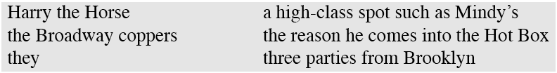
Constituency
For example, it makes sense to the say that the following are all noun phrases in English...
Why? One piece of evidence is that they all can precede verbs.
That’s what I mean by external evidence

Slide 10
Grammars and Constituency
Of course, there’s nothing easy or obvious about how we come up with right set of constituents and the rules that govern how they combine...
That’s why there are so many different theories of grammar and competing analyses of the same data.
The approach to grammar, and the analyses, adopted here are very generic (and don’t correspond to any modern, or even interesting, linguistic theory of grammar).

Slide 11
Context-Free Grammars
Context-free grammars (CFGs)
Part of the Chomsky hierarchy
Also known as
Phrase structure grammars
Backus-Naur form
Consist of
Rules
Terminals
Non-terminals

Slide 12
Context-Free Grammars
Terminals
Take these to be words (for now)
Non-Terminals
Correspond to the constituents in a language
Like noun phrase, verb phrase and sentence
Rules
Rules consist of a single non-terminal on the left and any number of terminals and non-terminals on the right.

Slide 13
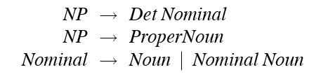
Some NP Rules
Here are some rules for noun phrases
These rules describe two kinds of NPs
One that consists of a determiner followed by a nominal
The flight
And another that says that proper names are NPs
JetBlue
The third rule demonstrates the recursive power of CFGs
Same non-terminal on the right and left-side of the rule
The morning flight

Slide 14
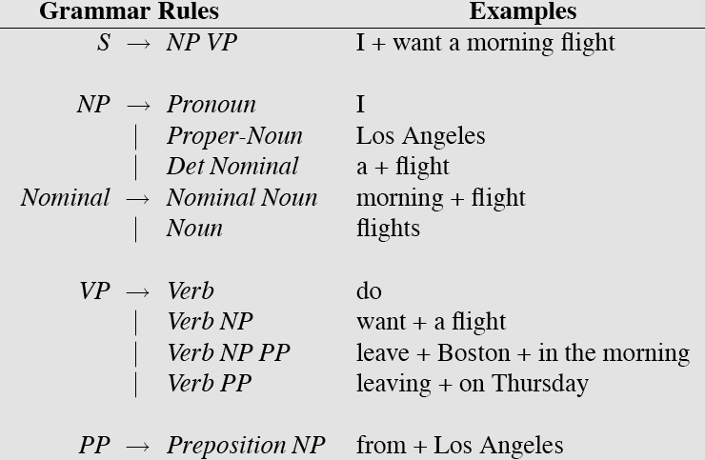
Toy Grammar

Slide 15
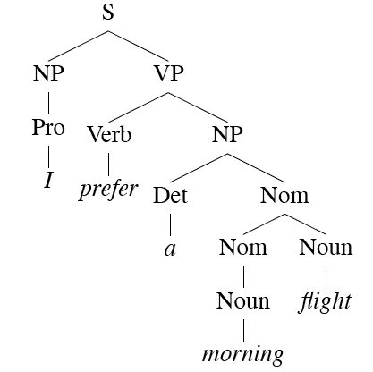
Derivations
A derivation is a sequence of rules applied to a string that accounts for that string
Covers all the elements in the string
Covers only the elements in the string

Slide 16
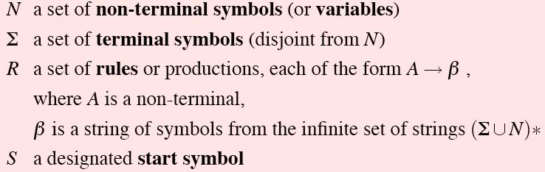
Definition
Formally, a CFG consists of

Slide 17
Parsing
Parsing is the process of taking a string and a grammar and returning derivation(s) for that string
Derivation == Parse Tree

Slide 18
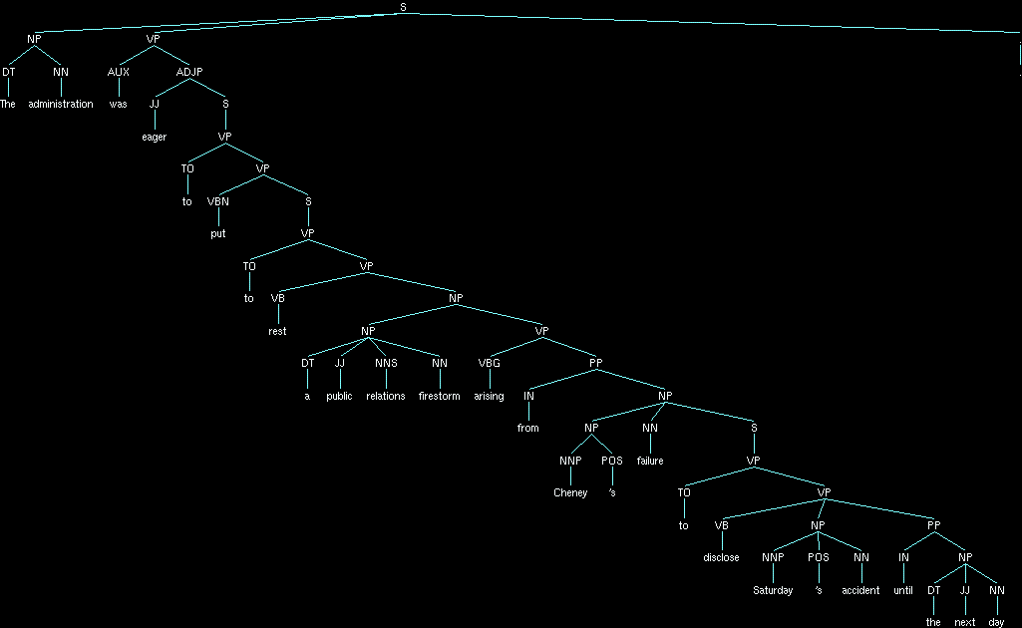
Automatic Syntactic Parse
Notes:
Make a point about the location/attachment of that PP

Slide 19
An English Grammar Fragment
Sentences
Noun phrases
Agreement
Verb phrases
Subcategorization

Slide 20
Sentence Types
Declaratives: A plane left.
S → NP VP
Imperatives: Leave!
S → VP
Yes-No Questions: Did the plane leave?
S → Aux NP VP
WH Questions: When did the plane leave?
S → WH-NP Aux NP VP

Slide 21
Noun Phrases
Let’s consider the following rule in more detail...
NP → Det Nominal
Much of the complexity of English noun phrases is hidden inside this one rule.
Consider the derivation for the NP in the following example
Give me all the morning flights from Denver to Tampa leaving before 10.

Slide 22
Noun Phrase Structure
Clearly this NP is really about “flights”. That’s the central organizing element (noun) in this NP.
Let’s call that word the head.
All the other words in the NP are in some sense dependent on the head
We can dissect this kind of NP into
the elements that come before the head
the head
the elements that come after it.

Slide 23
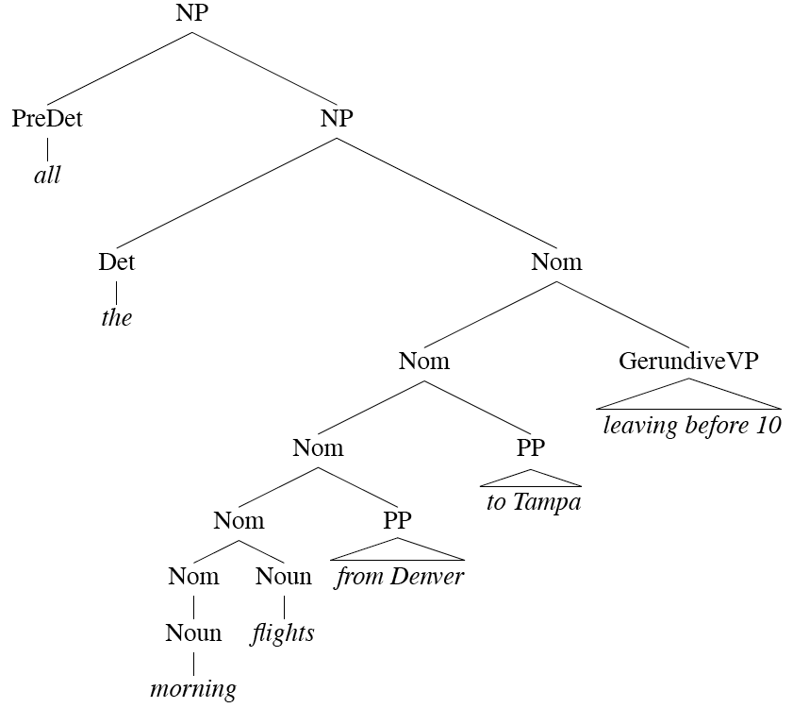
Noun Phrases

Slide 24
Determiners
Noun phrases can consist of determiners followed by a nominal
NP → Det Nominal
Determiners can be
Simple lexical items: the, this, a, an, etc.
A car
Or simple possessives
John’s car
Or complex recursive versions of possessives
John’s sister’s husband’s son’s car

Slide 25
Nominals
Contain the head and any pre- and post- modifiers of the head.
Pre-
Quantifiers, cardinals, ordinals...
Three cars
Adjectives
large cars

Slide 26
Postmodifiers
Three kinds
Prepositional phrases
From Seattle
Non-finite clauses
Arriving before noon
Relative clauses
That serve breakfast
Same general (recursive) rules to handle these
Nominal → Nominal PP
Nominal → Nominal GerundVP
Nominal → Nominal RelClause

Slide 27
Noun Phrases

Slide 28
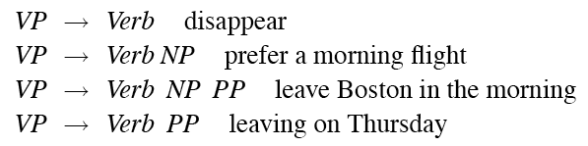
Verb Phrases
English VPs consist of a verb (the head) along with 0 or more following constituents which we’ll call arguments.

Slide 29
Subcategorization
Even though there are many valid VP rules in English, not all verbs are allowed to combine with all VP rules.
We can subcategorize the verbs in a language according to the sets of VP rules that they participate in.
This is just an elaboration on the traditional notion of transitive/intransitive.
Modern grammars have many such classes

Slide 30
Subcategorization
Sneeze: John sneezed
Find: Please find [a flight to NY]_{NP}
Give: Give [me]_{NP}[a cheaper fare]_{NP}
Help: Can you help [me]_{NP}[with a flight]_{PP}
Prefer: I prefer [to leave earlier]_{TO-VP}
Told: I was told [United has a flight]_{S}
Have: They had [me]_{NP}[leaving in the morning]_{VP}

Slide 31
Programming Languages Analogy
It’s useful to view things as follows
Verbs are functions or methods
We can specify the number, position, and type of the arguments they expect to take
That is, just like the formal arguments to a function.

Slide 32
CFG Summary
CFGs give us just about what we need to account for a lot of basic syntactic structure in English.
But there are problems
That can be dealt with adequately, although not elegantly, by staying within the CFG framework.
There are simpler, more elegant, solutions that take us out of the CFG framework (beyond its formal power)
LFG, HPSG, Construction grammar, XTAG, etc.

Slide 33
Treebanks
Treebanks are corpora in which each sentence has been paired with a parse tree (presumably the right one).
These can be created
Directly by human annotators
By first parsing the collection with an automatic parser and then having human annotators hand correct each parse
Conversion from a treebank in a different formalism
This generally requires detailed annotation guidelines that provide a POS tagset, a grammar, and instructions for how to deal with particular grammatical constructions.

Slide 34
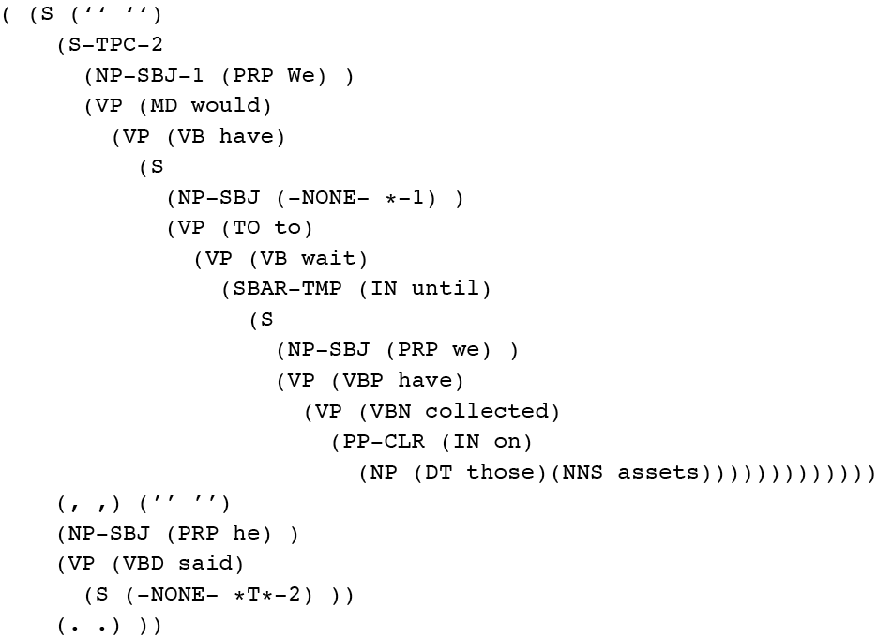
Penn Treebank
Penn TreeBank is a widely used treebank.
Most well known part is the Wall Street Journal section of the Penn TreeBank.
1 M words from the 1987-1989 Wall Street Journal.

Slide 35
Treebank Grammars
Treebanks implicitly define a grammar for the language covered in the corpus.
Take the local rules that make up the sub-trees in all the trees in the collection and you have a grammar
The WSJ section gives us about 12k rules if you do this
Not complete, but if you have decent size corpus you will have a grammar with decent coverage.

Slide 36
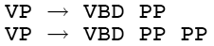
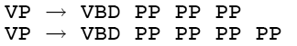
Treebank Grammars
Such grammars tend to be very flat due to the fact that they tend to avoid recursion.
To ease the annotators burden
For example, the Penn Treebank has ~4500 different rules for VPs. Among them...

Slide 37
Head Finding
Finding heads in treebank trees is a task that arises frequently in many applications.
As we’ll see it is particularly important in statistical parsing
We can visualize this task by annotating the nodes of a parse tree with the heads of each corresponding node.

Slide 38
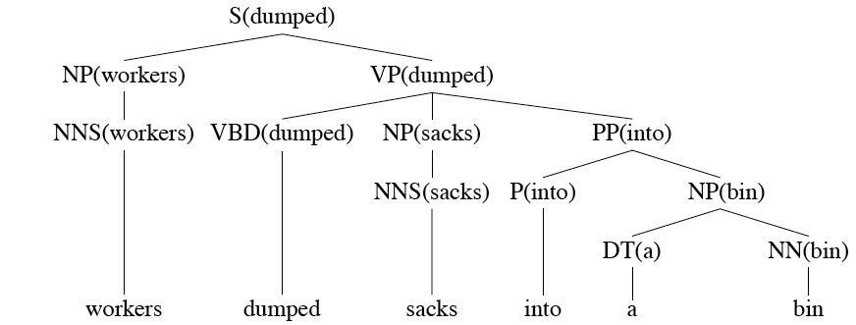
Lexically Decorated Tree

Slide 39
Head Finding
Given a tree, the standard way to do head finding is to use tree traversal rules specific to each non-terminal in the grammar.
They basically specify which child of a rule will lead to the head of the phrase

Slide 40
Noun Phrases

Slide 41
Treebank Uses
Treebanks (and head-finding) are particularly critical to the development of statistical parsers
Chapter 13
Also valuable to Corpus Linguistics
Investigating the empirical details of various constructions in a given language

Slide 42
Parsing
Parsing with CFGs is the task of assigning proper trees to input strings
Proper here means a tree that covers all and only the elements of the input and has an S at the top
It doesn’t mean that the system can select the contextually correct tree from among all the possible trees

Slide 43
For Now
Let’s assume…
You have all the tokenized words for a sentence already in some buffer
The input is not POS tagged prior to parsing
We won’t worry about morphological analysis
All the words are known
These are all problematic in various ways, and would have to be addressed in real applications.

Slide 44
Search Framework
It’s productive to think about parsing as a form of search…
A search through the space of possible trees given an input sentence and grammar
This framework suggests that heuristic search methods (such as A*) or dynamic programming methods will be useful

Slide 45
Problems
The key problem that our natural language parsers have to deal with is ambiguity
This ambiguity leads to uncertainty in the search and the potential for repeated work

Slide 46
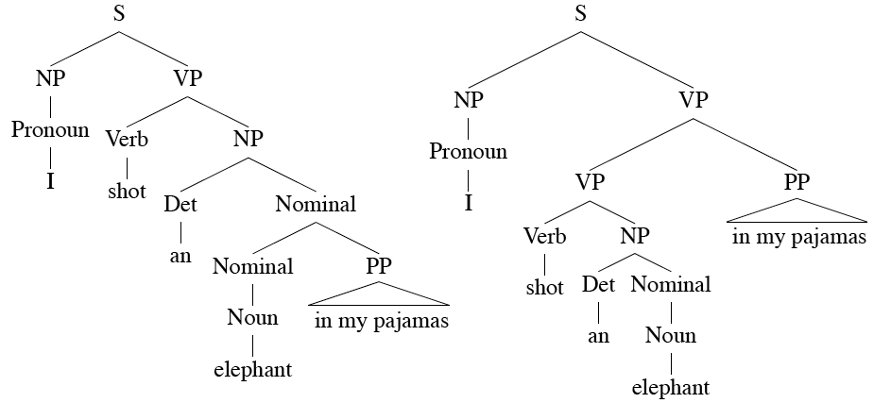
Ambiguity

Slide 47
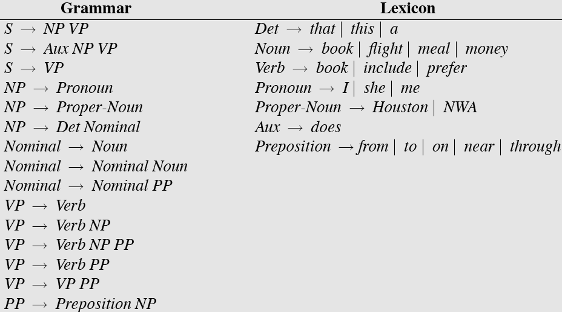
Sample L1 Grammar

Slide 48
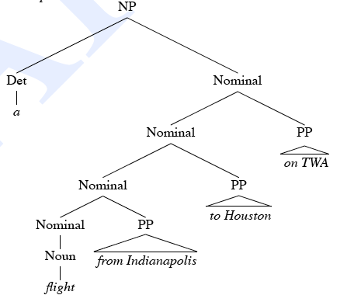
Shared Sub-Problems
Consider
A flight from Indianapolis to Houston on TWA

Slide 49
Shared Sub-Problems
Assume a top-down parse that has already expanded the NP rule (dealing with the Det)
Now its making choices among the various Nominal rules
In particular, between these two
Nominal -> Noun
Nominal -> Nominal PP
Statically choosing the rules in this order leads to the following bad behavior...

Slide 50
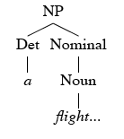
Shared Sub-Problems

Slide 51
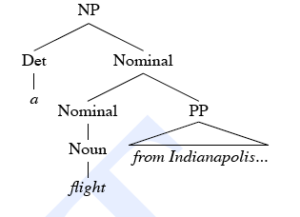
Shared Sub-Problems

Slide 52
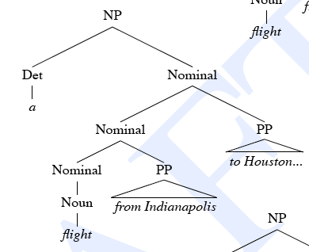
Shared Sub-Problems

Slide 53
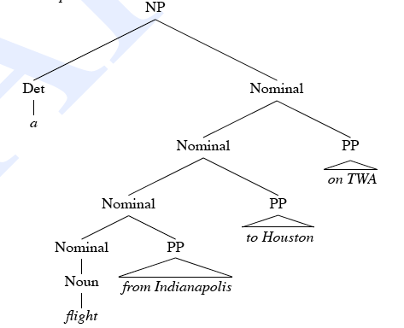
Shared Sub-Problems

Slide 54
Dynamic Programming
DP methods fill tables with partial results and thereby
Avoid doing avoidable repeated work
Solve exponential problems in polynomial time (ok, not really)
Efficiently store ambiguous structures with shared sub-parts.
Next time we’ll cover one approach (CKY) that corresponds to a bottom-up strategy

